Slide 1

Approvals in Fusion ERP Cloud

Slide 2
Concepts to look at
Approvals in Fusion – An Overview
BPM Related Roles & Configure Tasks
Task Assignment & Routing
Approval Notifications
Approval Management Key Components
Hands on with Payables Invoice Approval
Task Configuration
BPM Workflows Database Tables
Migration of Approval Rules

Slide 3
Approvals in Fusion – An Overview
Review business transactions to prevent frauds and scandals
Implemented through Workflow based tools
Approvals in Fusion is built on Oracle BPM (Business Process Management) Suite
BPM Workflows consists of two major components viz. Business Rules and Human Workflow
Business Rules is a repository of all approval rules defined and build the approval list based on the outcome of rules being satisfied
Human Workflow is to bring in human interaction such as sending out notifications to the approval list, capturing notification etc.
Can be correlated to Workflows and AME rules of Oracle E-Business Suite

Slide 4
BPM related Roles & Configure Tasks
BPM Related Roles
Configure Tasks
  Navigation:
    Setup and Maintenance → Tasklist → Search → Manage Task Configurations %
    Setup and Maintenance → Select Setup: Financials → Manage Expense Approval Rule (select any approval rule)
Product Family | Role Name (Role Code) | Predefined Job Roles Assigned To
All | BPM Workflow All Domains Administrator Role (BPMWorkflowAllDomainsAdmin) | None
All | BPM Workflow System Admin Role (BPMWorkflowAdmin) | Application Implementation Consultant (ORA_ASM_APPLICATION_IMPLEMENTATION_CONSULTANT_JOB) Financial Application Administrator Human Capital Management Application Administrator Procurement Application Administrator Supply Chain Application Administrator
Financials (FIN) | BPM Workflow Financials Administrator (BPMWorkflowFINAdmin) | Financial Application Administrator (ORA_FUN_FINANCIAL_APPLICATION_ADMINISTRATOR_JOB)
HCM | BPM Workflow Human Capital Management (BPMWorkflowHCMAdmin) | Human Capital Management Application Administrator (ORA_HRC_HUMAN_CAPITAL_MANAGEMENT_APPLICATION_ADMINISTRATOR_JOB)
Procurement (PRC) | BPM Workflow Procurement Administrator (BPMWorkflowPRCAdmin) | Procurement Application Administrator (ORA_PO_PROCUREMENT_APPLICATION_ADMIN_JOB)
SCM | BPM Workflow Supply Chain Administrator (BPMWorkflowSCMAdmin) | Supply Chain Application Administrator (ORA_RCS_SUPPLY_CHAIN_APPLICATION_ADMINISTRATOR_JOB)
* Roles are shown only for ERP Cloud (FIN, PRC, SCM) and HCM Cloud

Slide 5
Task Assignment & Routing
Stage
  Serial or Sequential
  Parallel
Approval List
  Supervisory
  Job Level
  Position
  Approval Group
  Resource
  Management Chain
Participants
  Serial
  Parallel (100% or All)
  Single (First Responder Wins)
  FYI
Voting Regime
  100% or All
  Majority Wins
  First Responder Wins

Slide 6
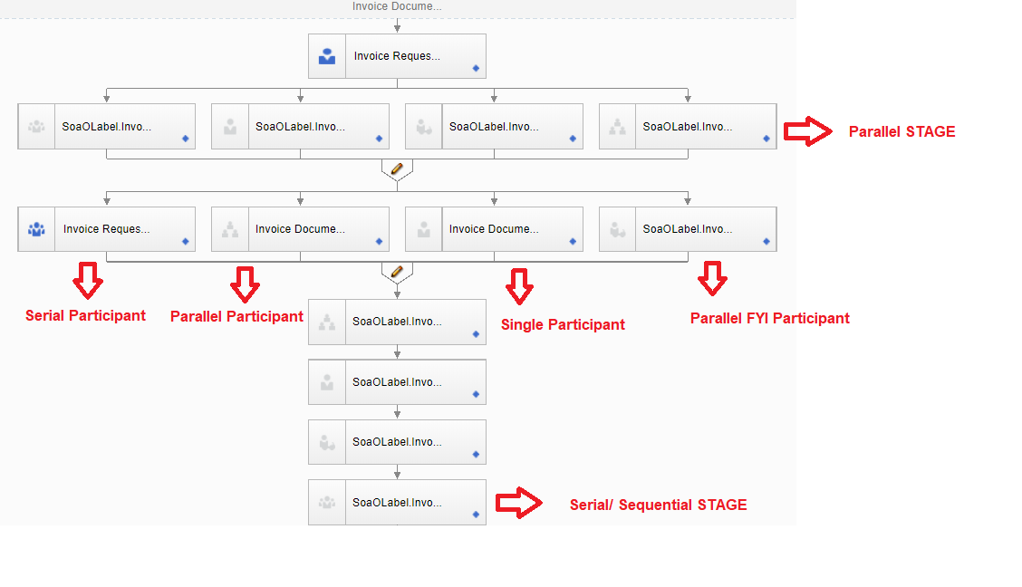
Task Assignment & Routing ...

Slide 7
Approval Notifications
Notification Statuses
  Assigned
  Completed
  Information Requested
  Suspended
  Withdrawn
  Errored
  Expired
  Completed
Notification Actions
  Approve
  Reject
  Request More Information
  Reassign
  Withdraw
  Adhoc Routing
  Escalate
  Delegate
Notification Mode
  ALL (Web & EMAIL)
  EMAIL
  NONE
  In-app
Notification Access Channels
  Federated Worklist
  BPM Worklist
  Bell Icon
  Email
  Product UI

Slide 8
Approval Management Key Components
Oracle SOA Suite Approval Management Extensions
  Basically Human Workflow service of Oracle SOA Suite used as core approval functionality in Oracle Fusion applications
  Integrates with HCM to derive approvers and build the approval list
  Provides framework to define approval rules for various business documents e.g. Journal, Invoice etc.
  Provides ability to select complex routing patterns based on the business processes
Oracle Business Process Management (BPM) Suite
  A Web based application
  Provides an interface to work with various notifications tasks assigned to business users and can drill down to the task assigned and can perform necessary approval action
  Provides an interface to set up and manage approval rules
Oracle Fusion Human Capital Management (HCM)
  Basically a product to define various employee hierarchies like supervisory, job-based, position-based
  Inputs list of approvers to Approval Management Extensions if approval rule is configured based on HCM Hierarchies

Slide 9
Hands on using Payables Invoice Approval
Use Case to be demonstrated
  Business Unit is “US1 Business Unit”
  Invoice Type is “STANDARD”
  Invoice Amount is as follows
    < 100 → auto approval
    >=1000 & <5000 → Approval Group
    >= 5000 & <10000 → Supervisory 2 level
    >=10000 → Resource

Slide 10
Pre-requisites for Approver Lists
Supervisory Hierarchy
Approver Group
Resource
Employee | User Name | Approval Level
Invoice, Clerk | invoice.clerk | 0
Brown, Casey | CASEY.BROWN | 1
Kennedy, Anita | ANITA.KENNEDY | 2
Taylor, William | WILLIAM.TAYLOR | 3
Group Name | User Name
Sample Group | FIN_IMPL
Employee | User Name
Taylor, William | WILLIAM.TAYLOR

Slide 11
Test Payables Invoice Approval
Use Case to be demonstrated
  Business Unit is “US1 Business Unit”
  Invoice Type is “STANDARD”
  Invoice Amount is as follows
    < 100 → auto approval
    >=1000 & <5000 → Approval Group
    >= 5000 & <10000 → Supervisory 2 level
    >=10000 → Resource
Invoice Number | Invoice Amount | Expected | Result
Invoice101 | 50 | Auto Approved | Pass
Invoice102 | 2000 | Sample Group | Pass
Invoice103 | 6000 | CASEY.BROWN → ANITA.KENNEDY | Pass
Invoice104 | 11000 | WILLIAM.TAYLOR | Pass

Slide 12
Task Configuration
Deadlines Settings
  Expiration Settings
Notifications Settings
  Reminder Settings
Configuration Settings
Preferences
  Vacation Rules
Task Attributes

Slide 13
BPM Workflows Database Tables
FA_FUSION_SOAINFRA.WFTASK
FA_FUSION_SOAINFRA.WFASSIGNEE
FA_FUSION_SOAINFRA.WFCOMMENTS
FA_FUSION_SOAINFRA.WFATTACHMENT
FA_FUSION_SOAINFRA.WFTASKASSIGNMENTSTATISTIC
FA_FUSION_SOAINFRA.WFTASKHISTORY
FA_FUSION_SOAINFRA.WFMESSAGEATTRIBUTE
FA_FUSION_SOAINFRA.WFAPPROVALGROUPS
FA_FUSION_SOAINFRA.WFAPPROVALGROUPMEMBERS
FA_FUSION_SOAINFRA.WFCOLLECTIONTARGET

Slide 14
Migration of Approval Rules
Navigation
  <Fusion POD>/soa/composer
How?
  Export SOA Changes
  Import SOA Changes
Demonstrate
Important Note:
  The source and destination environments should have same version

